Slide 1
Showing What We Know: Authentic Assessment of Young Dual Language Learners Through Play
Dr. Douglas Bell
dbell22@kennesaw.edu

Slide 2
Best Practices in DLL Assessment
Age appropriate
Culturally & linguistically appropriate (including bias and stereotype free)
Include home language & language of instruction (including translanguaging)
Take language proficiency in consideration
Variety of methods
Be authentic and make use of familiar/comfortable contexts

Slide 3
Language Samples
Quick and easy
Brief "snap shot of language use"
Show use of language at that moment
Should be exact quote and show pronunciation if possible
Include home language, and translanguaging if possible

Slide 4
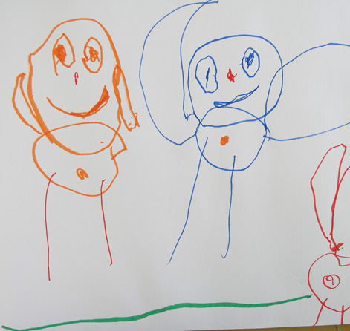
Work Samples
Quick and easy
Show current level of ability
Not used for what can't show
Should always be paired with language samples for DLL

Slide 5
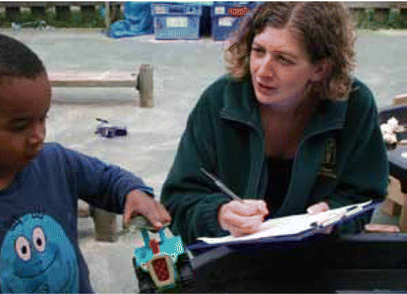
Observations
Quick and easy
Show what occurred
Separate fact from opinion
Anecdotal and checklist formats are most used
Should always be paired with language samples for DLL

Slide 6
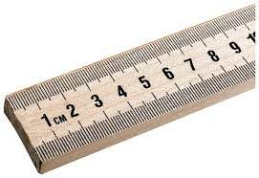
Measuring Progress Against Criteria (language)
Language development
Home language proficiency
Second Language proficiency
Using the Components or Building Blocks of Language
Phonology
Morphology
Semantics
Syntax
Pragmatics
Taxonomy / sequence of language skill

Slide 7
Measuring Progress Against Criteria (concepts)
Learning target or objective (should always be included whenever possible)
Early learning standard
Developmental play stage or developmental stage
Taxonomy / sequence of concept or skill

Slide 8
Taxonomy or Continuum Checklist
Break down into logical sequence of steps
In order of developmental progression
As general or refined as you need

Slide 9
References
de Villiers, J. (2015, May). Taking account of both languages in the assessment of dual language learners. In Seminars in Speech and Language (Vol. 36, No. 02, pp. 120-132). Thieme Medical Publishers.
Espinosa, L. M., & García, E. (2012). Working paper #1: Developmental assessment of young dual language learners with a focus on kindergarten entry assessment: Implications for state policies. Chapel Hill: The University of North Carolina, FPG Child Development Institute, Center for Early Care and Education Research-Dual Language Learners.
Farnsworth, M. (2018). Differentiating second language acquisition from specific learning disability: An observational tool assessing dual language learners’ pragmatic competence. Young exceptional children, 21(2), 92-110.
Guzman‐Orth, D., Lopez, A. A., & Tolentino, F. (2017). A framework for the dual language assessment of young dual language learners in the United States. ETS Research Report Series, 2017(1), 1-19.
Peña, E. D., & Halle, T. G. (2011). Assessing preschool dual language learners: Traveling a multiforked road. Child Development Perspectives, 5(1), 28-32.

